Slide 1

MOBILE DEVELOPMENT
COMPUTER SCIENCE
Topic 7:
Cloud Services
version 1.0
Copyright © 2020 by Singapore Institute of Management Pte Ltd. All rights reserved.

Slide 2

Learning Outcomes
After studying this topic and the recordings online, you should be able to:
Topic 7 – Cloud Services
What are Cloud Services
Why use Cloud Services
Popular Cloud Services
Reachability
HTTP Get
HTTP Post

Slide 3

What is a Cloud Service?
The term "cloud services" refers to a wide range of services delivered on demand to companies and customers over the internet.
These services are designed to provide easy, affordable access to applications and resources, without the need for internal infrastructure or hardware.
Notes:
B

Slide 4
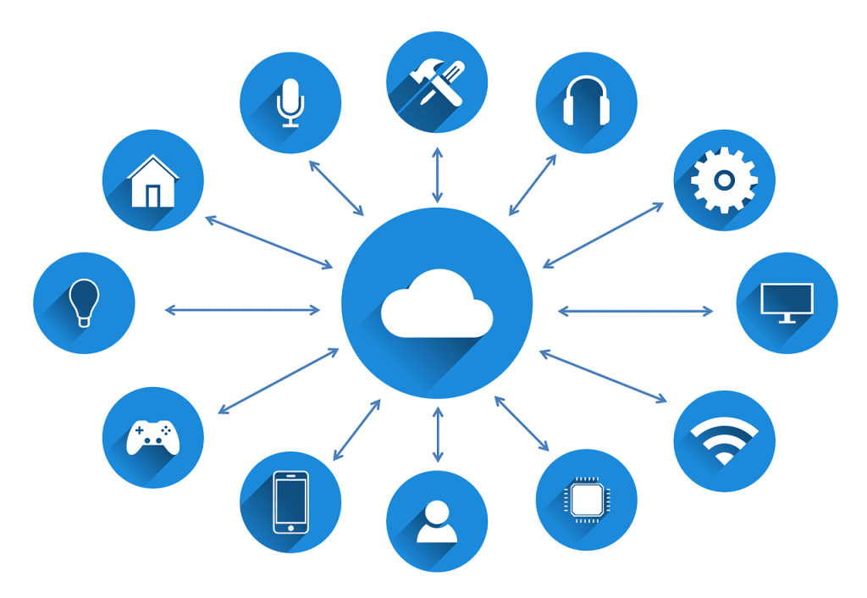
What is a Cloud Service?
From checking email to collaborating on documents, most employees use cloud services throughout the workday, whether they’re aware of it or not.
Notes:
B

Slide 5
What is a Cloud Service?
Cloud services are fully managed by cloud computing vendors and service providers.
They’re made available to customers from the providers' servers, so there's no need for a company to host applications on its own on-premises servers.
Notes:
B

Slide 6
Why use Cloud Service?
Back in the past, developers have to own a private server to host services and maintain it on their own.
Then in 1994, the first web hosting was created by GeoCities.
The platform, which was bought by Yahoo! in 1999, allowed users to upload pages of content in virtual ‘cities’ that were relevant to the subject of the content.
GeoCities hosted those pages.
Notes:
B

Slide 7
Why use Cloud Service?
Back in the past, developers have to own a private server to host services and maintain it on their own.
Then in 1994, the first web hosting was created by GeoCities.
The platform, which was bought by Yahoo! in 1999, allowed users to upload pages of content in virtual ‘cities’ that were relevant to the subject of the content.
GeoCities hosted those pages.
Notes:
B

Slide 8

Why use Cloud Service?
How GeoCitites look like.
Notes:
B

Slide 9
Why use Cloud Service?
By 1998, shared hosting was created to allow small scale developers to host their own server space at an affordable cost but limited specifications.
Till date, there are multiple shared hosting services provided.
Exabytes
Hostgators
GoDaddy
And more
Notes:
B

Slide 10
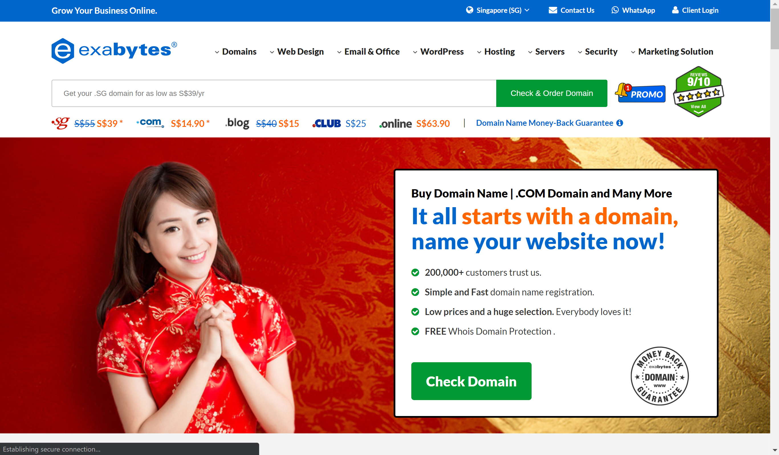
Why use Cloud Service?
A quick look at Exabytes. (https://exabytes.sg)
Notes:
B

Slide 11
Why use Cloud Service?
A quick demonstration of a few shared hosting services.
Notes:
B

Slide 12
Why use Cloud Service?
So why use Cloud Services if there are Shared Hosting Services.
Lack of Security
Increased Downtime
Higher Risk of Data Loss
Insufficient Customization
Lack Scalability
Lack Full Control
Notes:
B

Slide 13
Popular Cloud Services
SaaS also know as Software as a Service, is a service that delivers a software application which the cloud service provider manages to its users.
Typically, SaaS apps are web applications or mobile apps that users can access via a web browser.
Software updates, bug fixes, and other general software maintenance are taken care of for the user, and they connect to the cloud applications via a dashboard or API.
Notes:
B

Slide 14
Popular Cloud Services
Saas examples includes:
Spotify
Google Drive
Office 365
Any software that provides a range of software services.
Notes:
B

Slide 15
Popular Cloud Services
IaaS also known as Infrastructure as a Service.
Means a cloud service provider manages the infrastructure for you. The actual servers, network, virtualization, and data storage are accessed through an internet connection.
The user manages things like the operating system, apps, and middleware while the provider takes care of any hardware, networking, hard drives, data storage, and servers.
Notes:
B

Slide 16
Popular Cloud Services
IaaS popular examples includes:
Microsoft Azure
Google Cloud
Amazon Web Service
Alibaba Cloud
Notes:
B

Slide 17
Popular Cloud Services
PaaS also know as Platform as a Service.
Allows developers to build applications without web interface. Without any need for a database. The main thing is to access the platform’s provided services.
Examples includes:
Amazon Web Services
Microsoft Azure
IBM
Google Cloud
Notes:
B

Slide 18
Popular Cloud Services
There are FOUR (4) main types of Cloud.
Public Clouds
Private Clouds
Dedicated Clouds
Hybrid Clouds
Notes:
B

Slide 19
Popular Cloud Services
Public Clouds
Public clouds are cloud environments typically created from IT infrastructure not owned by the end user.
All clouds become public clouds when the environments are partitioned and redistributed to multiple tenants.
Fee structures aren't necessary characteristics of public clouds anymore, since some cloud providers allow tenants to use their clouds for free.
Notes:
B

Slide 20
Popular Cloud Services
Private Clouds
Private clouds are loosely defined as cloud environments solely dedicated to a single end user or group, where the environment usually runs behind that user or group's firewall.
All clouds become private clouds when the underlying IT infrastructure is dedicated to a single customer with completely isolated access.
Notes:
B

Slide 21
Popular Cloud Services
Hybrid Clouds
A hybrid cloud is a seemingly single IT environment created from multiple environments connected through local area networks (LANs), wide area networks (WANs), virtual private networks (VPNs), and/or APIs.
Notes:
B

Slide 22
Popular Cloud Services
Multi Clouds
Multiclouds are a cloud approach made up of more than 1 cloud service, from more than 1 cloud vendor—public or private.
All hybrid clouds are multiclouds, but not all multiclouds are hybrid clouds.
Multiclouds become hybrid clouds when multiple clouds are connected by some form of integration or orchestration.
Notes:
B

Slide 23
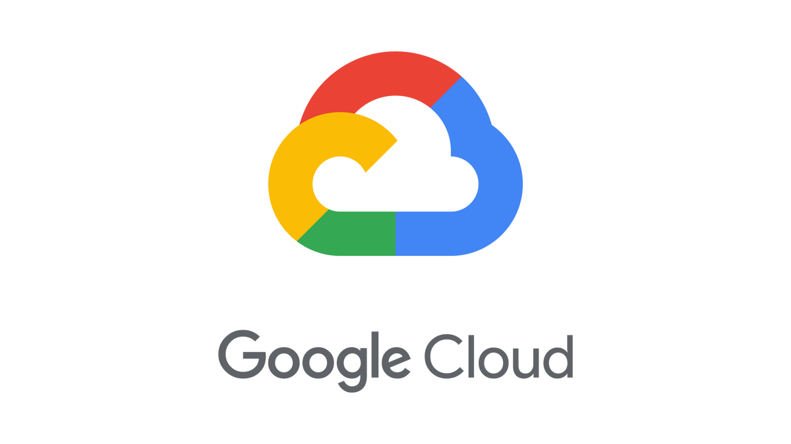
Popular Cloud Services
Let’s take a look at one popular cloud service, Google Cloud.
Notes:
B

Slide 24
Reachability
Detecting Active Connections
For SaaS mobile application, it is most often required to use Internet to retrieve information and then feeding it to the interface.
There will be certain scenarios where internet connectivity is temporarily unavailable and we need to ensure that the mobile application is able to detect and correspond to this situation accordingly.
Notes:
B

Slide 25
Reachability
Detecting Active Connections
In React Native, we will be using TWO(2) network library APIs that detects the Internet Network status and perform corresponding actions.
expo-network (latest)
Provides useful information about the device's network such as its IP address, MAC address, and airplane mode status.
Notes:
B

Slide 26
Reachability
Detecting Active Connections
NetInfo
React Native Network Info API for Android, iOS, macOS, Windows & Web. It allows you to get information, Connection type and Connection quality.
Notes:
B

Slide 27
Reachability
Detecting Active Connections
Now let’s have a demonstration on both of the Network Libraries.
Notes:
B

Slide 28
HTTP Get
Retrieving data from the internet
HTTP Get provides the most basic and incredibly useful way of getting information from a remote server.
Example:
https://example.com/testing?id=123&name=joe
The ? refers to starting a list of parameters to send to the server.
The & refers to defining a new parameter.
Notes:
B

Slide 29
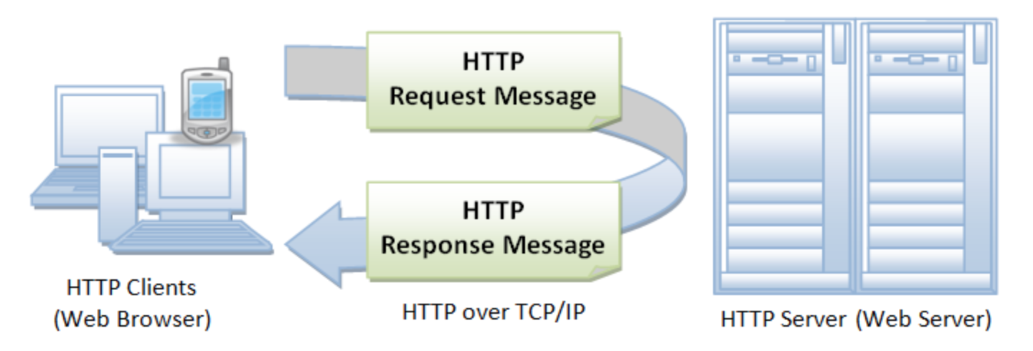
HTTP Get
Retrieving data from the internet
*Diagram reference from, https://www.ntu.edu.sg/home/ehchua/programming/webprogramming/http_basics.html
Notes:
B

Slide 30
HTTP Get
Retrieving data from the internet
Remember the fetch API?
Now we are going to try out on how to fetch a simple JSON data from the Internet using the fetch API Get method.
Notes:
B

Slide 31
HTTP Get
Retrieving data from the internet
We are going to use the Internet Archive to fetch some data.
The link that we will be using:
https://archieve.org/metadata/principleofrelat00eins
Notes:
B

Slide 32
HTTP Post
HTTP post is similar to HTTP get.
It also sends a request to the server with parameters, but with a different method.
Both of these request protocols are the backbone of the internet in terms of communication.
Notes:
B

Slide 33
HTTP Post
Example of an HTTP Post request:
Content-Type: application/x-www-form-urlencoded
Content-Length: 27
key=value&id=value&item2=value.
Notes:
B

Slide 34
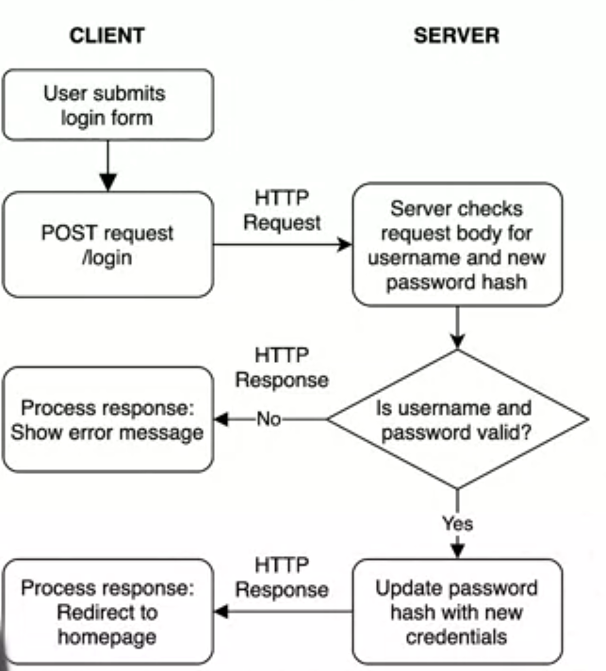
HTTP Post
Diagram of a Post request
(Coursera, Mobile Develop
-ment, 2022)
Notes:
B

Slide 35
HTTP Post
Now we are going to try out on how to fetch a simple JSON data from the Internet using the fetch API Post method.
Notes:
B

Slide 36
That’s all for today!
If you have any questions, please feel free to reach out to me at this email.
kydsim001@mymail.sim.edu.sg
Notes:
B

Slide 37
END OF LESSON

